Slide 1
LEARNING PYTHON

Slide 2
AGENDA
LEARNING PYTHON INPUT AND OUTPUT DATA TYPE

Slide 3
What is Python?
Python is an interpreted, object-oriented, high-level programming language with dynamic semantics. Its high-level built in data structures, combined with dynamic typing and dynamic binding, make it very attractive for Rapid Application Development, as well as for use as a scripting or glue language to connect existing components together. Python's simple, easy to learn syntax emphasizes readability and therefore reduces the cost of program maintenance. Python supports modules and packages, which encourages program modularity and code reuse. The Python interpreter and the extensive standard library are available in source or binary form without charge for all major platforms, and can be freely distributed.

Slide 4
Python Jobs
Today, Python is very high in demand and all the major companies are looking for great Python Programmers to develop websites, software components, and applications or to work with Data Science, AI, and ML technologies. When we are developing this tutorial in 2022, there is a high shortage of Python Programmers where as market demands more number of Python Programmers due to it's application in Machine Learning, Artificial Intelligence etc.

Slide 5
Why to learn Phython?
Python is consistently rated as one of the world's most popular programming languages. Python is fairly easy to learn, so if you are starting to learn any programming language then Python could be your great choice. Today various Schools, Colleges and Universities are teaching Python as their primary programming language. There are many other good reasons which makes Python as the top choice of any programmer:

Slide 6
Python is Open Source which means its available free of cost.
Python is simple and so easy to learn
Python is versatile and can be used to create many different things.
Python has powerful development libraries include AI, ML etc.
Python is much in demand and ensures high salary

Slide 7
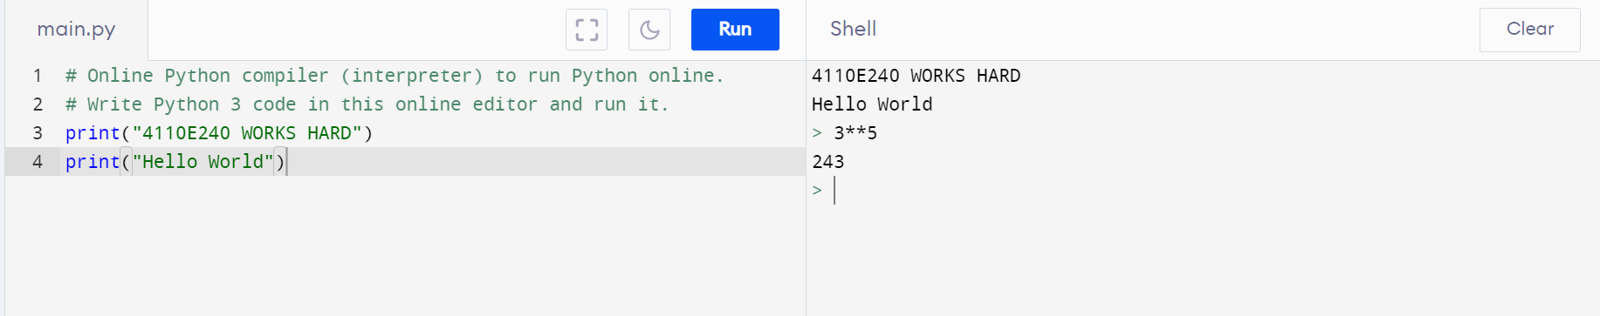
Python Online Interpreter: 1
INTERACTIVE

Slide 8
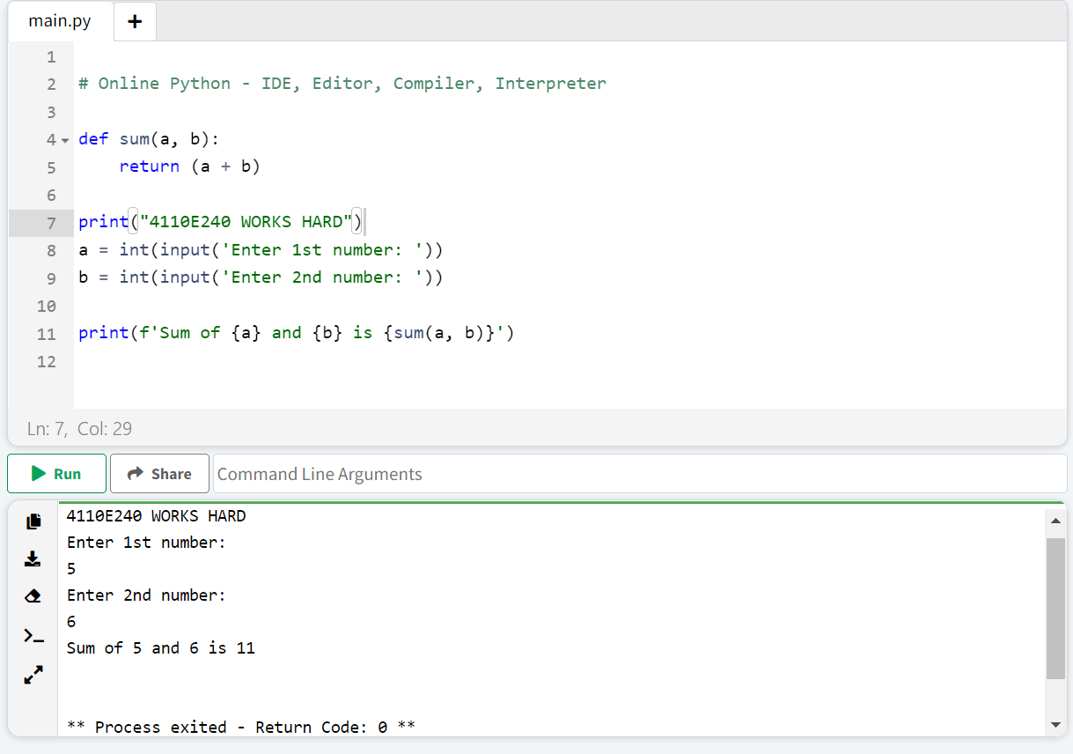
Python Online Interpreter: 2

Slide 9
Input and Output

Slide 10
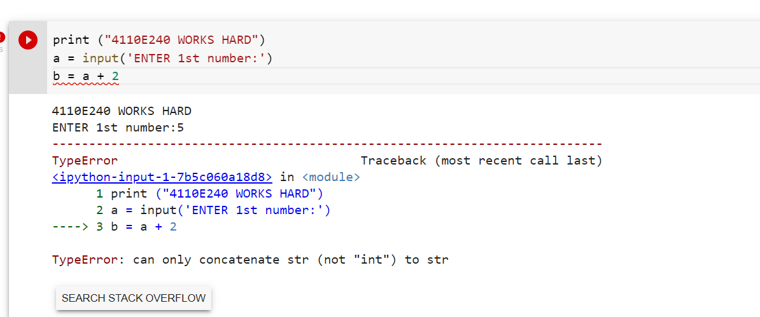
DATA TYPE

Slide 11
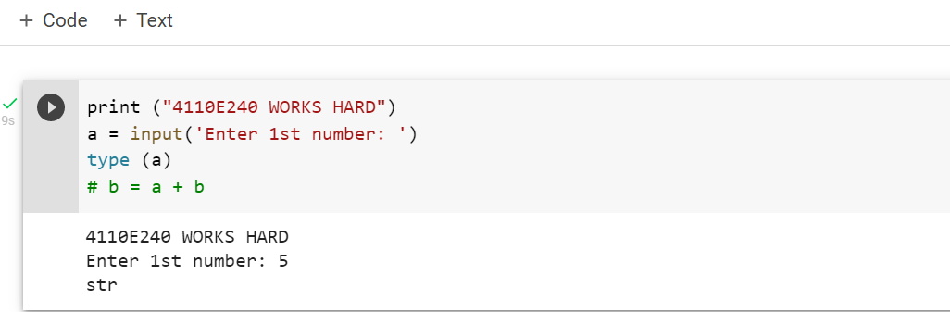

Slide 12
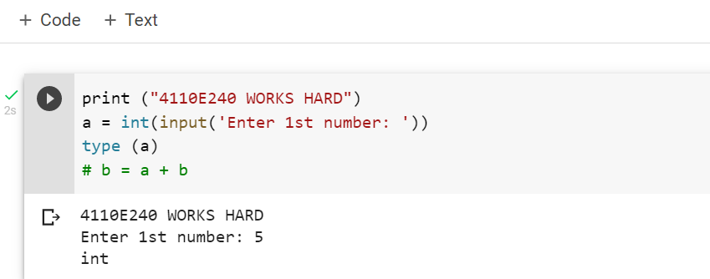

Slide 13
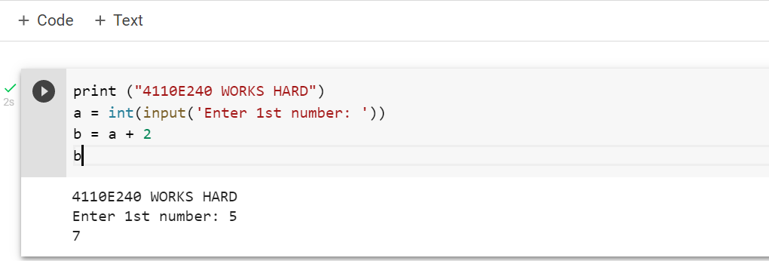

Slide 14
DATA TYPE

Slide 15
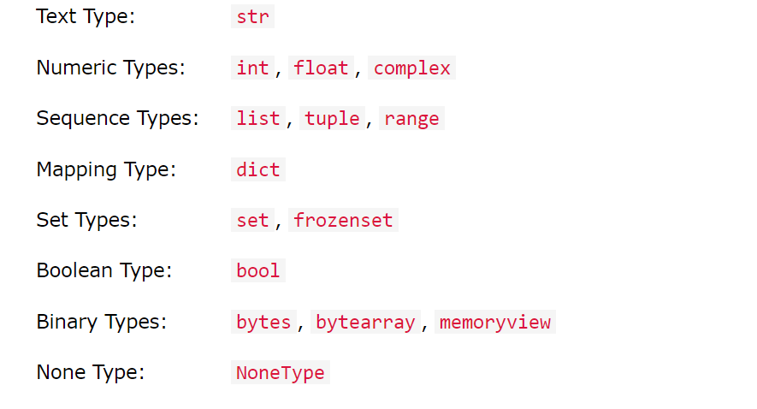
DATA TYPE

Slide 16
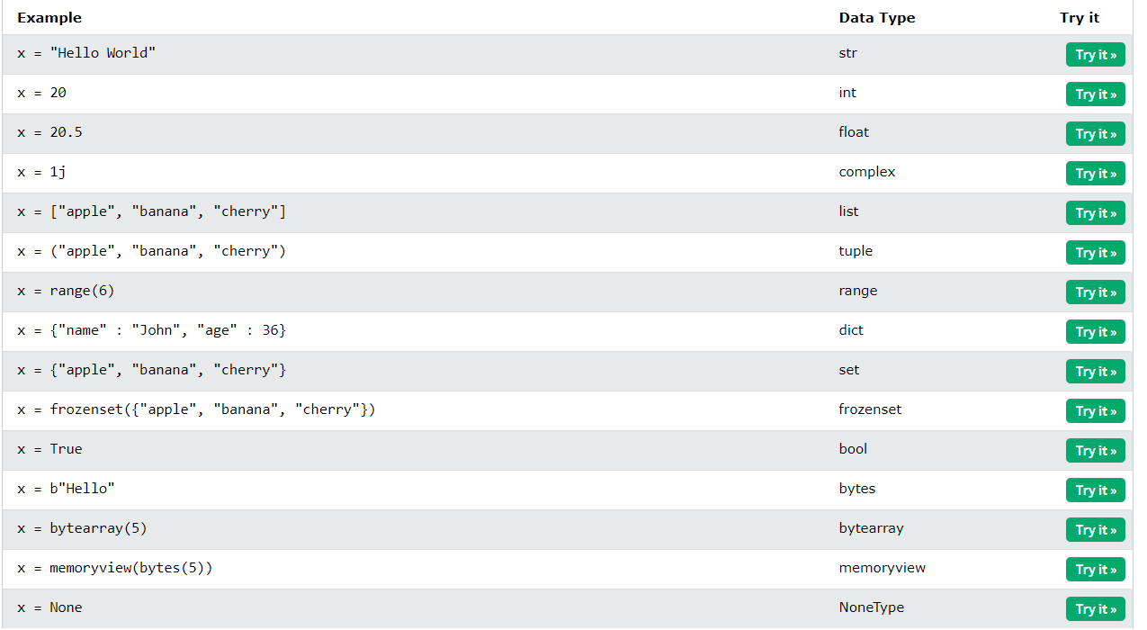

Slide 17
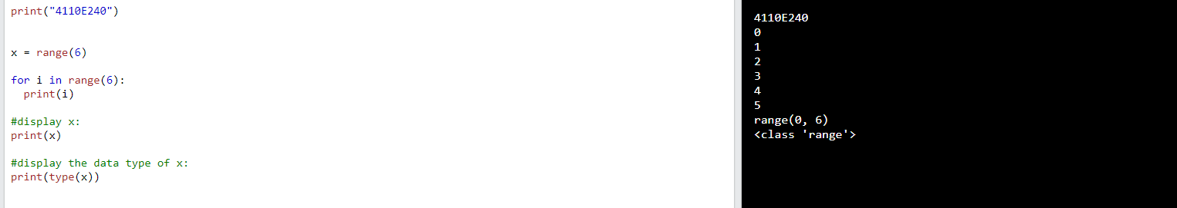

Slide 18
Operator @

Slide 19
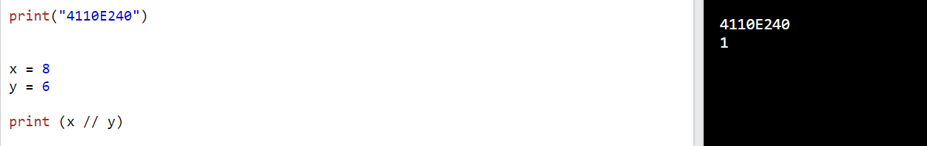
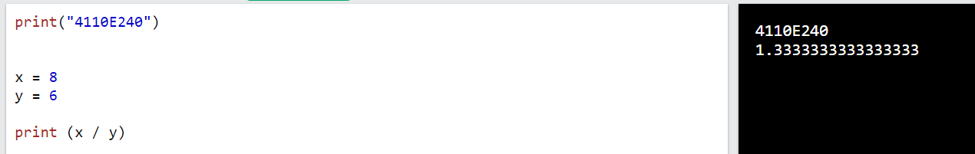

Slide 20
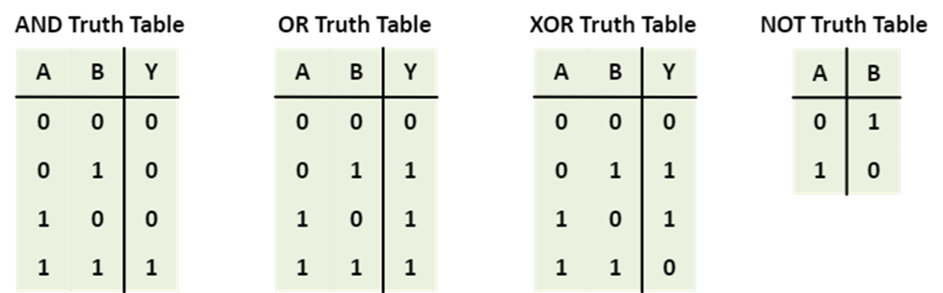

Slide 21
[“apple”, “banana”]
[“apple”, “banana”]
Z = X
Z
X
y
X is y == > False
X == y == > True

Slide 22
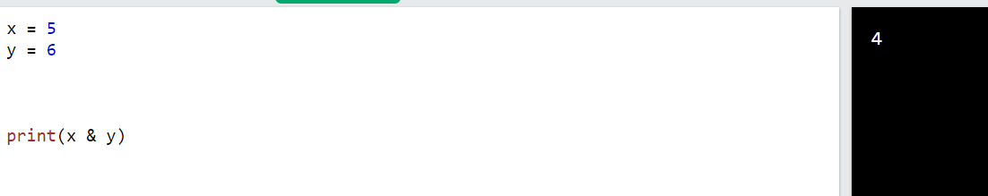
Binary
2
1
0
1 *2 +0*2 + 1 *2
2
X = 5 ( 1 0 1 ) Y = 3 ( 0 1 1 ) PriNT(X & Y] ( 001 )
2
2

Slide 23
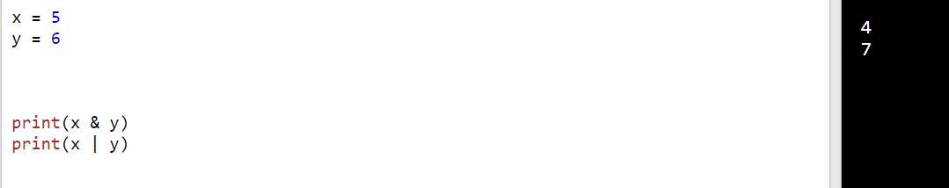
Exercise: how to get a 7 in bitwise-or

